Slide 1
Mother-Infant Study to Reduce Long-term Effects of
Neonatal Abstinence Syndrome

Slide 2
NAS Infants 2012-2016
(Eskenazi and Methodist NICUs)

Slide 3
1
Cohort Study
2
Implementation Study
3
Randomized Control Study

Slide 4
Overview
WeCare Indiana and plan for adaptation for working with an NAS population
RCT of mother-child NAS dyads involving 2 arms: WeCare and Circle of Security
Data elements to allow both retrospective and prospective analysis of RCT dyads: descriptive study and enriched follow up data

Slide 5




WeCare Indiana: Improving Maternal and Infant Health to Reduce Infant Mortality
PI: Deb Litzelman

Slide 6





Project Overview
Partner with community organizations to co-develop, document and evaluate strategies that support maternal healthy life-course and infant health
Implement WeCare Indiana program, with health coaches and tailored mHealth messages
Focus on high priority risk factors for infant mortality
Maternal Health Factors
  Smoking
  Mental Health: substance use (prescription drugs, illicits), alcohol, depression, anxiety
  Obesity/Nutrition: food insecurity, lifestyle, diet, exercise
Infant Health Factors
  Safe Sleep
  Breastfeeding
Evaluate effectiveness
Disseminate findings
Reduce infant mortality across all races and SES groups in Marion and Delaware Counties
Notes:
----- Meeting Notes (8/25/15 21:13) -----
Introductions
Deb Litzelman-Director of Research in Health Professions Practice and Education within the HSR Center in RG
-career in HSR studying health behaviors, behavioral change strategies, working with providers delivering care as IP collaborative care teams, using information systems as clinical decision support and data collection tools.
-most recently lead the education and training core for the ABC CMS Innovation grant training a cadre of CHW to deliver direct care to elderly pt and their care givers in their home
Sarah Wiehe-Director of Community Health Engagement Programs for CTSI
Lisa Staten--Chair of the Department of Social and Behavioral Sciences at the Fairbanks SPH
We chose to focus on IM because IN is ranked 39th in the US for IM with 8 deaths per 1000 birth per year; Marion and Delaware counties are ranked even higher than the state ranking; Marion Co with 10 deaths/1000 births and Delaware with 9 deaths/1000 births. Statistics are even more concerning for AA in Marion county at 13 deaths per 1000 births.
Partner
Implement-
Importantly, IM is also considered a epidemiologic indicator of health punctuating the importance several high priority risk factors for IM also considered as major concerns for IN in IUH’s Community Need Assessment including Smoking, Obesity, and Mental Health. We chose to focus on two high priority infant health factors based on IN State Health Ranking data as well as county specific data-Safe Sleep and Breastfeeding
We plan to evaluate the effectiveness by focusing on a bundle of health indicators including process measures such as educational interventions delivered though mHealth and reinforced by health coachs and outcome measures including a variety of health behaviors
Disseminate-local, county, state, national levels-through regular case conferences, county level FIMR groups, ISHD, as well as nationally

Slide 7
Tailored Health Education
Health Coaching
  Community Health Workers
  Carefully selected from the local community
Tailored mHealth educational messaging
  For the 5 targeted indicators
  Social Determinants of Health: The Basics (food, housing, heat)
  Bi-directional secure messaging system; dashboard for data capture

Slide 8
Y1 Study Participants: Demographics
Campaign | ODHS N=120 (%) | RHC N=117 (%) | Total N=238 (%)
Pregnant | 108 (90) | 101 (86) | 209 (88)
Postpartum | 11 (9) | 13 (11) | 24 (10)
Childbearing Age | 1 (1) | 4 (3) | 5 (2)
Age
< 18 | 6 | 4 | 10 (4)
18-25 | 61 | 46 | 107 (45)
26-30 | 26 | 32 | 58 (24)
31-35 | 15 | 20 | 35 (15)
> 35 | 10 | 5 | 15 (6)
Race
White | 91 (76) | 13 (11) | 104 (44)
Black | 19 (16) | 95 (81) | 114 (48)
Other | 10 (8) | 10 (8) | 20 (8)
Notes:
ODHS-Open Door Health Services in Muncie
Raphaei Health Service in Indianapolis

Slide 9
Process Measures
Screening for Risk Factors/Establish Prevalence
  Smoking
  Mental Health: Depression, anxiety, substance abuse
  Nutrition: Diet, exercise, lifestyle habits
  Safe sleep practices
  Breastfeeding
  The Basics
Educational Interventions
  # of SMS messages sent
  # of coaching sessions

Slide 10
Y1 Preliminary Outcomes:
Improved Health Behaviors
Smoking –reduction/cessation (5%)
Substance Abuse*-reduction/cessation (77%)
Mental Health-PHQ-9/GAD-7 improved (30%)
Nutrition-fewer skipped meals in last week (33%)
Safe Sleep-more sleeping alone on back (20%)
Breastfeeding-continued for > 3 months (80%)
* Note: a very small number of patients screened positive for SA

Slide 11
WeCare Plus: An Innovative, Community-Based, Collaborative Initiative to Decrease Infant Mortality
Indiana State Department of Health’s SafetyPIN Initiative
1 of 10 funded
$2.1 M awarded with focus on Central Region
Expand to include other FQHCs in Marion County:
Eskenazi Community Health Centers (11)
HealthNet Clinics (4)
Shepherd Community Health Center (1)
Raphael Health Center (1)

Slide 12
Care Plus: An Innovative, Community-based Addiction Reduction plus
Policy Innovations Program for Indiana
Background and Rationale for Study:
Care Plus is planned as a partnership of healthcare, public, and community organizations, designed to reduce Opiate mortality and addiction in Indiana, beginning with pilot implementation in three counties (Marion, Delaware, and one other southern Indiana county) through outreach, health coaching, community engagement, and mobile health (mHealth) messaging technology.
Notes:
Next Steps to Address Opioid Addiction Treatment and Recovery Options for WeCare patients
Target Clients with Opioid Addiction identified by WeCare CHW and fortify with support of treatment and recovery options through proposed CARE Plus program

Slide 13
Specific Aim One
Care Plus CHW coaches training and clinical decision and SMS messaging support tools will be expanded to include a more comprehensive screening, care, and resource tool kit for clients with opioid and illicit drug use.

Slide 14
Specific Aim Two
On-going in-services will be provided to NICU staff about the Care Plus program to link mothers and fathers of children born with NAS with Care Plus CHW in non-urgent situations to assist with appropriate treatment plans and referrals and on-going recovery coaching.

Slide 15
Specific Aim Three
First Responders will be trained using materials similar to Care Plus CHW education materials and will help screen and link community members using opioid and illicit drugs with CHW in non-urgent situations to assist in appropriate treatment plans and referrals and on-going recovery coaching.

Slide 16
Specific Aim Four
Develop human-centered monitoring and evaluation programs to conduct detailed root cause analyses of high opiate morbidity/ mortality communities and develop community-driven solutions to address their opiate abuse challenges.

Slide 17
Mother-Infant Study to reduce long term effects of Neonatal Abstinence Syndrome

Slide 18
1
Cohort Study
2
Implementation Study
3
Randomized Control Study

Slide 19
Cohort
Parent-Infant pairs: neonates born with NAS
1. Demographics
2. Birth history (vag/CS/Pitocin)
3. Infant data: gestational age/weight/APGARS
3. Psychiatric history (including SA history)
4. Adverse Childhood Experiences
5. Attachment Security of parents
6. Paternal involvement

Slide 20
Implementation Study
Implementation of WeCare Plus in an NAS population
  CHW training
  CHW involvement with parents (personal contact/SMS)
  Connection to treaters
Implementation of Circle of Security in an NAS population
  CHW trained
  In hospital/outpatient follow-up in home

Slide 21
Randomized Control Study
50% of parents of NAS infants will participate in Circle of Security.
50% of parents of NAS infants will not participate in Circle of Security.

Slide 22
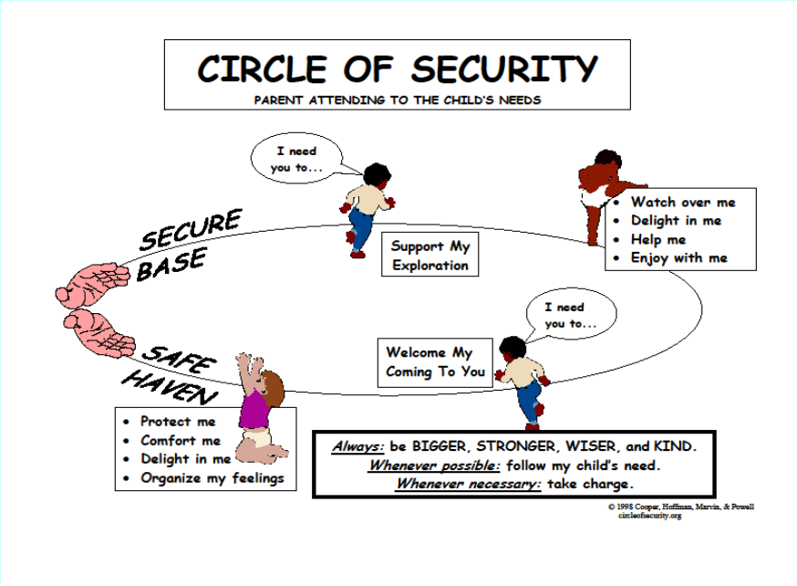

Slide 23
Neonates
All NAS Babies enrolled:
  Access to care for moms
  Treatment for babies
  Cortisol (Saliva)
  Oxytocin (Saliva)
  Vasopressin (Saliva)
  Genetic Testing (Saliva)
  WeCare
Randomized 50%:
  Circle of Security

Slide 24
Outcomes
Parental participation in MAT
Nicotine/drug/alcohol use
Breastfeeding
Rooming with infant
Parental presence
Skin-to-skin contact (hours)
Reliance on CHW for support (SMS, contact)
Depression/Anxiety (rating scales)
Parental Reflective functioning
Total amount of opiate used in infant
Discharge plans: home/foster
Length of Stay
Neurocognitive Development at 12 months
Mortality at 12 months

Slide 25
Supplemental data for RCT cohort
Leverage existing data for 2 objectives:
  Description of the pathways (correlates) of opioid-addicted pregnant women
  Enhanced description of near- and longer-term correlates and outcomes as they relate to both mother and baby→child→adolescent
Women in RCT consented for linkage with specified sources
Add expanded longitudinal ‘view’ of these dyads both before and (long) after recruitment

Slide 26
1
Cohort Study
2
Implementation Study
3
Randomized Control Study

Slide 27
Socio-ecological data elements
Organizational
(healthcare, schools, workplaces, justice agencies, social services)
Interpersonal
(family, friends, networks)
Individual
(mother-child dyad)

Slide 28
Measures/Data
Mothers

Slide 29
Measures/Data
Infants

Slide 30
Measures/Data
Young Children

Slide 31
Measures/Data
Older Children/Adolescents

