Slide 1
Brief Examples of Purdue Efforts in Opioid Abuse Mitigation
Paul Griffin
Regenstrief Center for Healthcare Engineering
July 13, 2017

Slide 2
4 Presentations
Jacqueline Linnes Assistant Professor, School of Biomedical Engineering
Kyle Hultgren Director, Center for Medication Safety Advancement
Kinam Park Showalter Professor, School of Biomedical Engineering
Randy Hountz Director, Purdue Healthcare Advisors

Slide 3
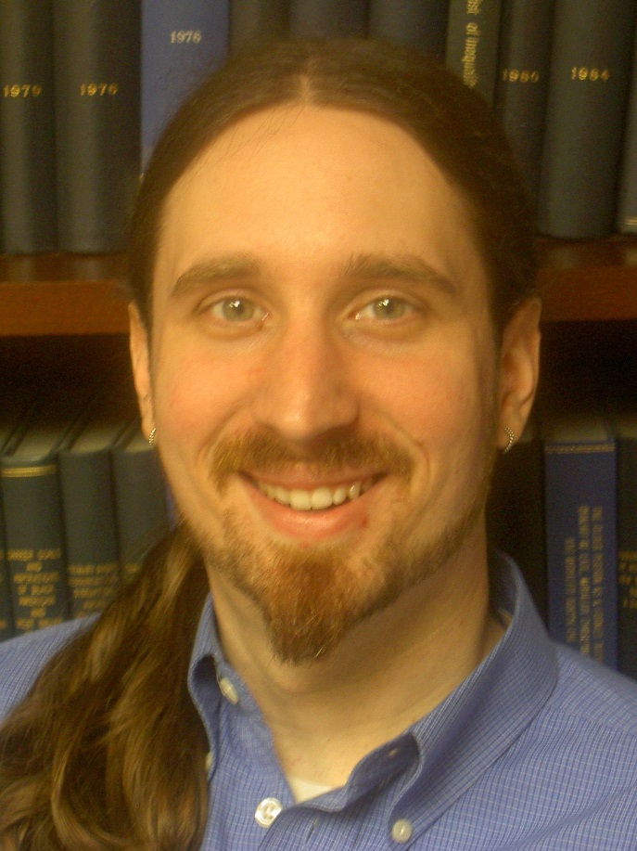
Brian Kelly
Director, Center on Research for Young People’s Health Department of Sociology and Anthropology
Areas of research interest include substance use, sexual health, HIV/AIDS, and comparative youth cultures.
Recent research projects include social contextual influences of prescription drug misuse among U.S. youth, the influence of policy contexts on youth substance use trajectories.

Slide 4
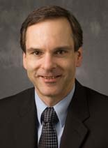
Dave Ebert
Silicon Valley Professor of ECE; director of VACCINE
Areas of research in public safety and public health visual analytics.
Visual Analytics for Command, Control, and Interoperability Environments Center (VACCINE), is the Department of Homeland Security’s Center of Excellence in Visual and Data Analytics. Focuses on creating methods, tools, and applications to analyze and manage vast amounts of information for all mission areas of homeland security in the most efficient manner.
Represented today by Dr. Jao Surakitbanharn

Slide 5
VALET)
Impacts:
Analyze crime patterns and to connect strings of activities
Investigate correlation factors
Analyze time of day problems and improve accuracy of police record management system
Novel statistical predictive model incorporated for planning
Incorporates predictive alerts

Slide 6
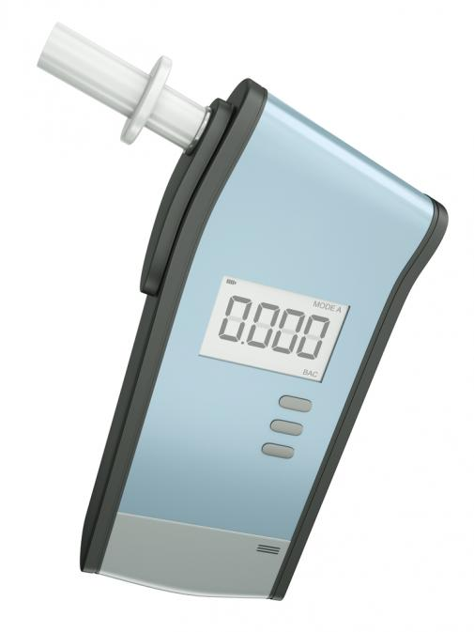
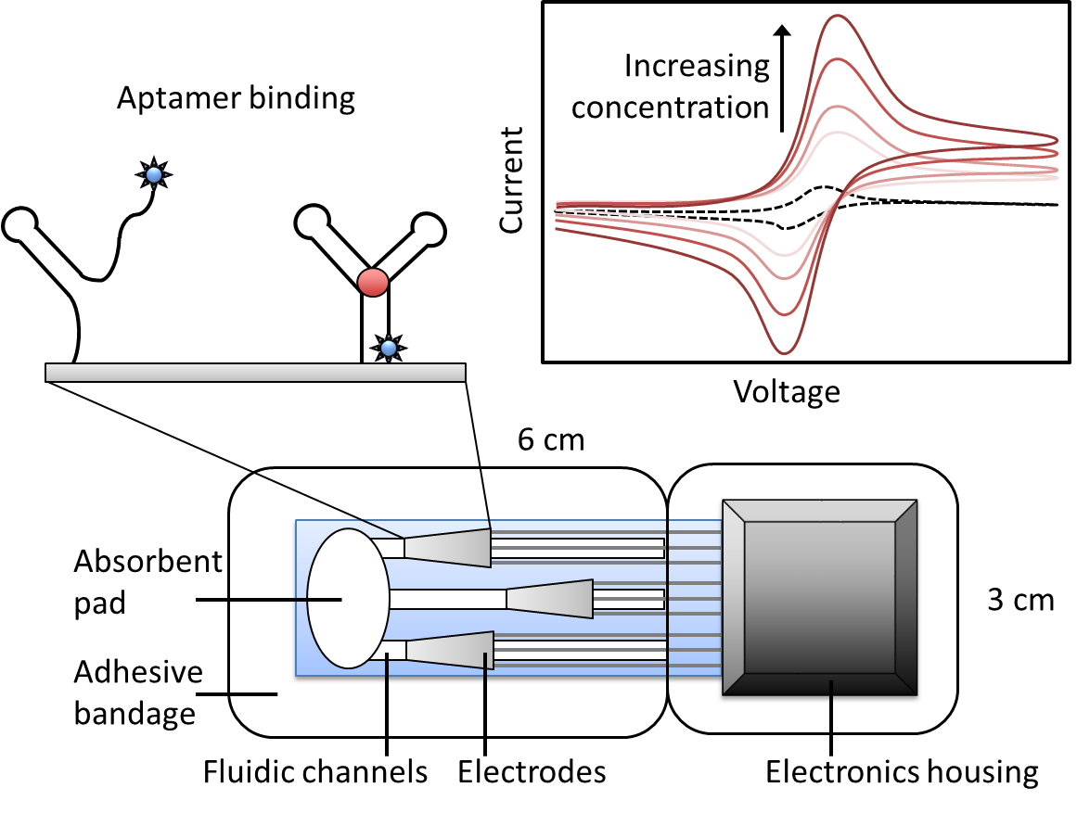
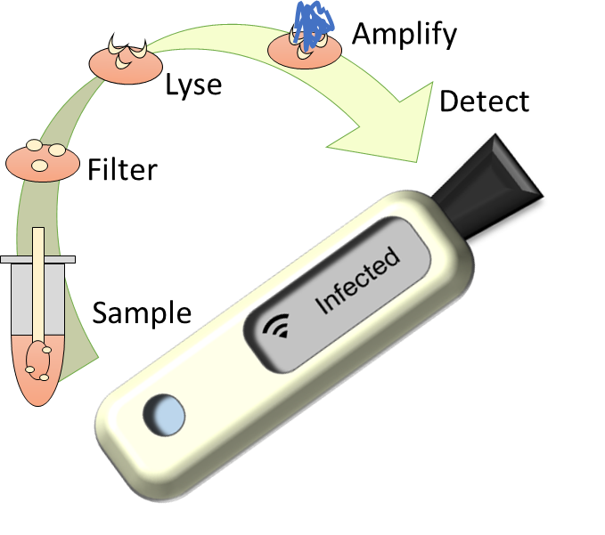
LINNES LAB
Dr. Jacqueline Linnes jlinnes@purdue.edu
Point-of-care molecular diagnostics
Glucose monitoring from breath
Wearable biosensors to detect narcotics
Real-time epidemiology for global health

Slide 7
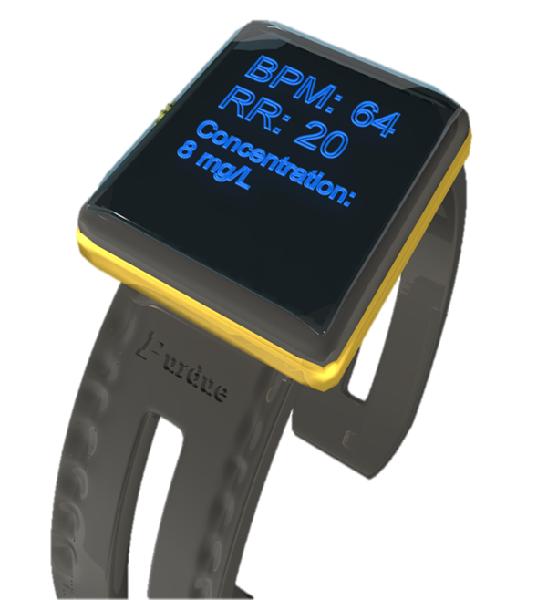
SMART Watch
Dr. Hugh Lee and Dr. Jacqueline Linnes
In collaboration with the British Columbia Center for Excellence in HIV/AIDS
Continuous biophysical monitoring for overdose detection
Heart rate
Blood oxygen saturation
Respiratory rate
Galvanic skin response
Movement/Activity
Location
Overdose Detected
Locate Patient
Low
No

Slide 8
Auto Calibrating Heart Rate Sensor
Movement
Heart rate (90 bpm)

Slide 9
Skin impedance – Startle reflex
startled

Slide 10
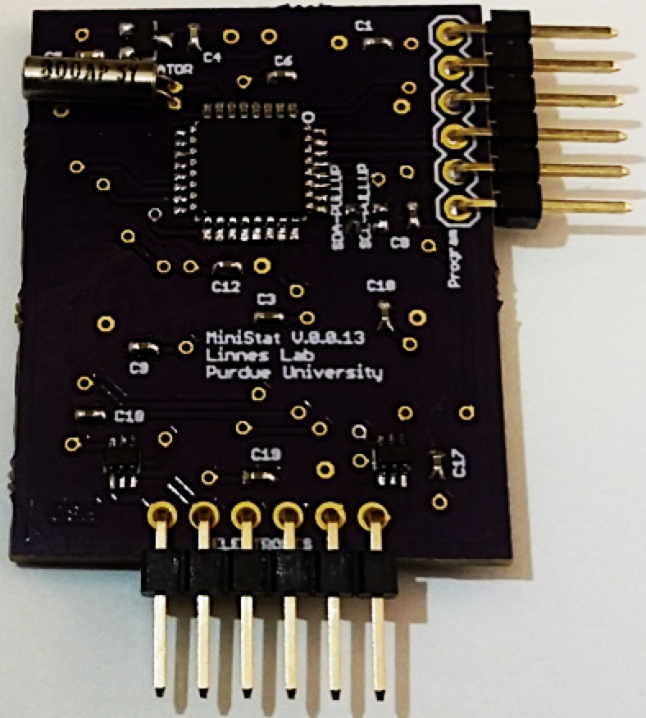
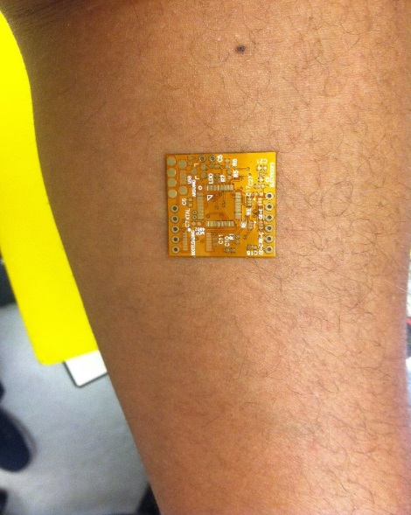
Detecting Usage
Sensor removed

Slide 11
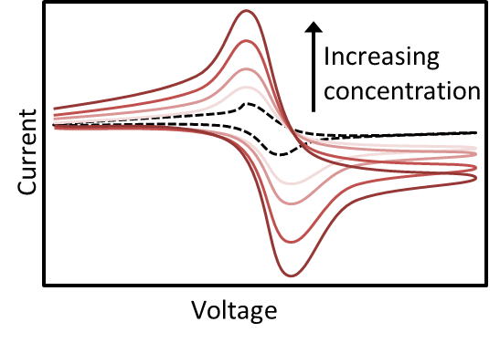
Wearable Sensor Platform for Drug Rehab
In collaboration with Dr. Kenzie Preston, Senior Investigator at NIDA
Adhesive patch to monitor drug use
Detect cocaine and opioids down to 3 ng/ul
Detection performed at least 4 times per 24 hours
Detection patch replaced once per 24 hours
Data storage for minimum 1 week
Wireless data transfer
Absorbent
pad
COC
NEG
3 cm
Adhesive
bandage
MOR
Electrodes
Electronics housing
Fluidic channels

Slide 12
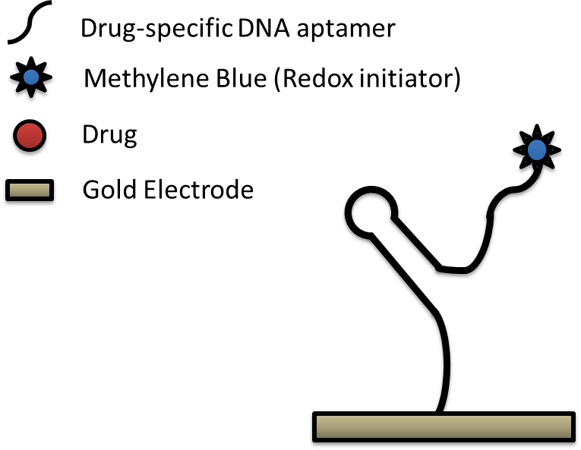
Direct Electrochemical Drug Sensing

Slide 13
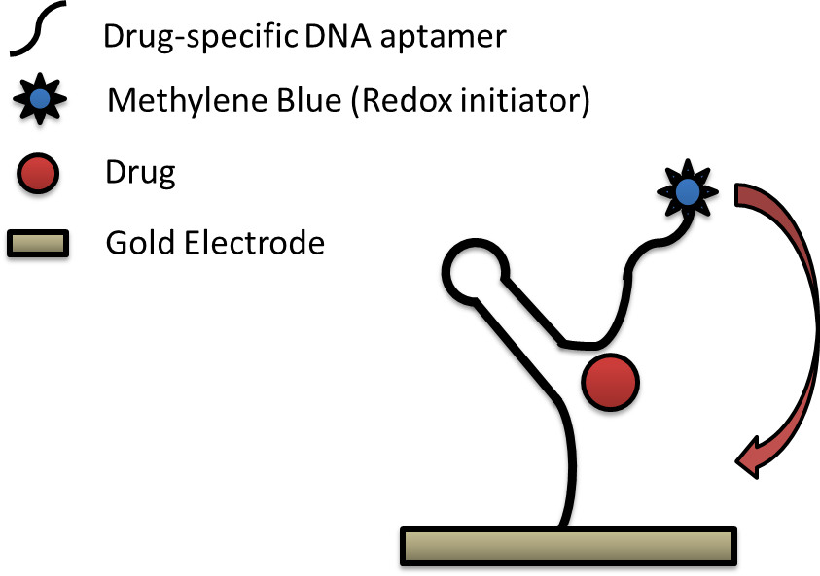
Direct Electrochemical Drug Sensing

Slide 14
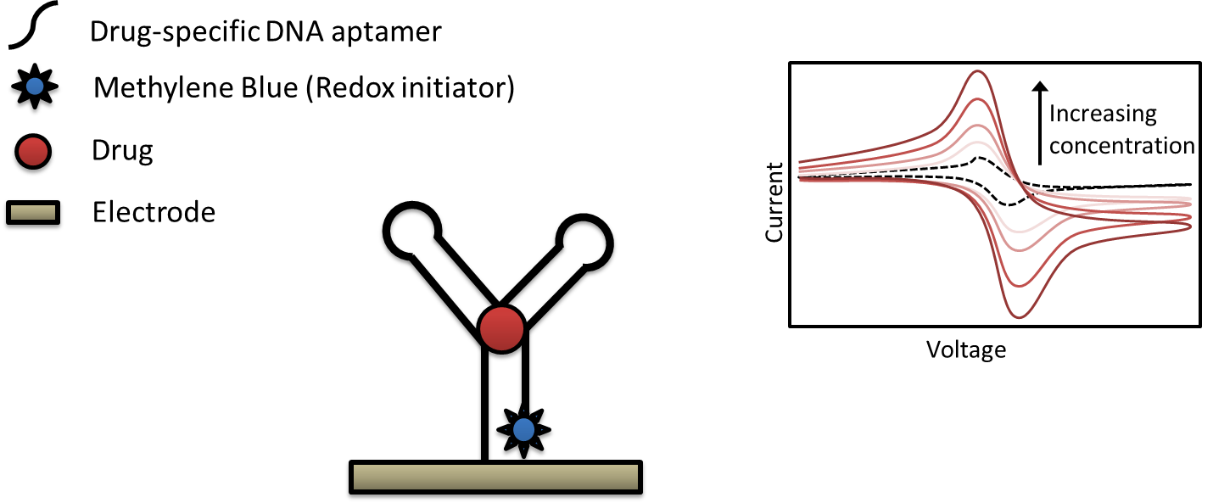
Direct Electrochemical Drug Sensing

Slide 15
Signal Response to Cocaine
w/ Cocaine
w/o Cocaine
Time

Slide 16
Consistent Signal Increase vs. Buffer
Control Electrode
Detection Electrode
Detection goal

Slide 17
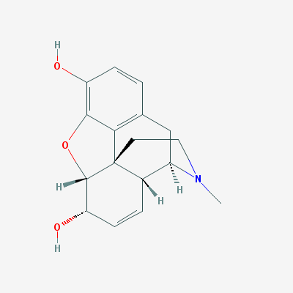
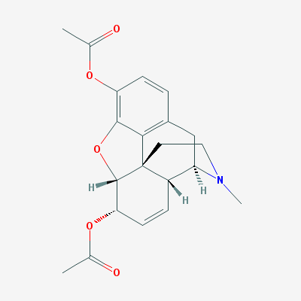
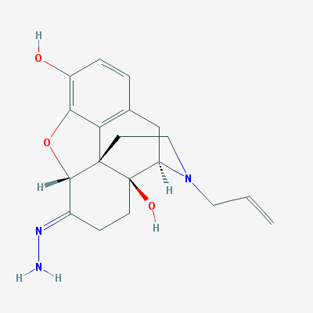
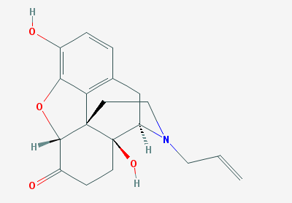
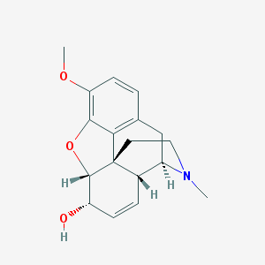
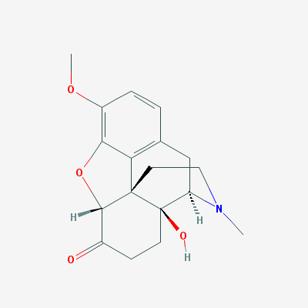
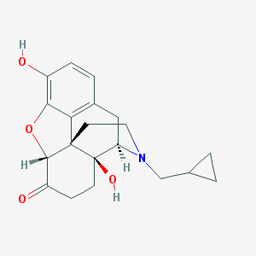
Future Opioid Abuse Targeting
Re-design DNA aptamer to bind opioid drugs
Mu opioid Agonists (Targeted)
Mu opioid Antagonists
(Off-target)
Nalaxone
Nalaxazone
Morphine
Heroin
Codeine
Oxycodone
Naltrexone

Slide 18
Rapid Early Viral Load Detection of HIV & HCV
Blood sample
A low-cost paper-based nucleic acid diagnostic platform with robust sample preparation and molecular amplification in a familiar detection format.
Automated sequential sample capture, virion lysis, isothermal amplification, and detection
Localized heating of printed wax valves automates fluid flow
Visual lateral flow detection readout
MicroUSB powered heating of amplification reaction
Roll-to-roll manufactured molecular diagnostic
Detection results
MicroUSB phone powered
Amplification
reagents
Sample inlet
and filter
Waste
Pad
Visual detection readout
Printed temperature
responsive valves

Slide 19
CMSA Update on Opioid Takeback Program
Kyle E. Hultgren, PharmD
Director | Center for Medication Safety Advancement

Slide 20
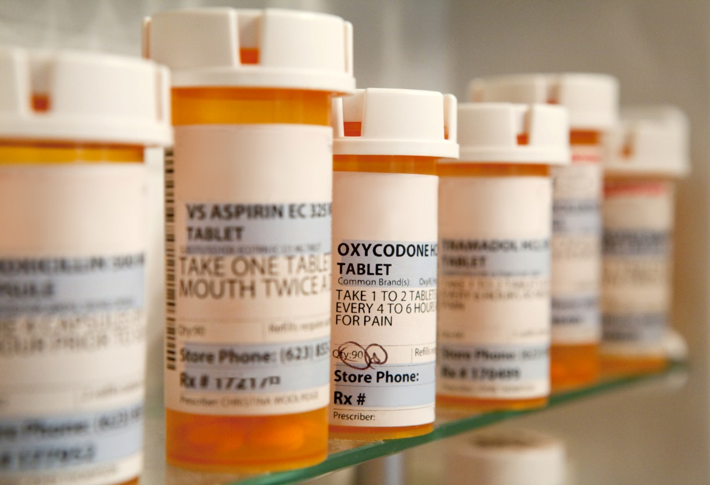
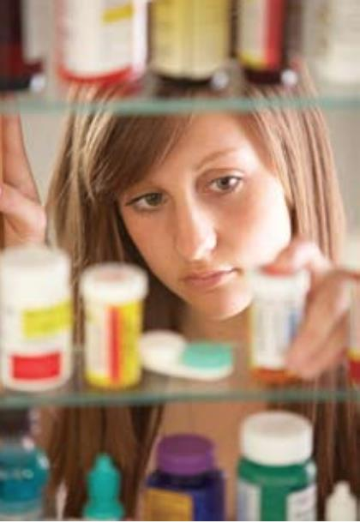
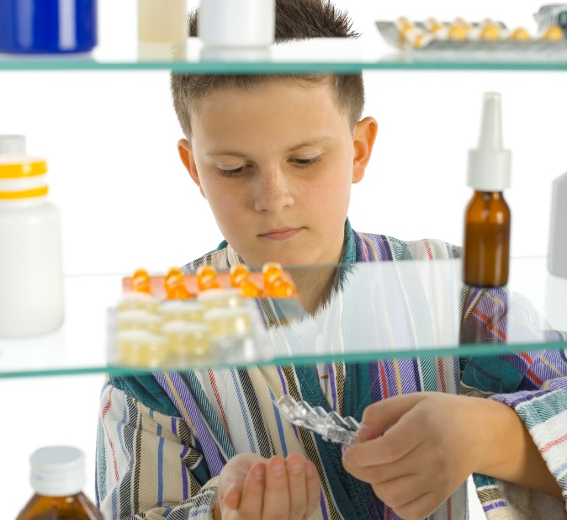
Unintended Access to Opioids

Slide 21
Take Back Programs
Laws can vary between states
Many pharmacies cite significant barriers to taking back unused medications
Costs are not insignificant
Not a lot of great options currently

Slide 22
Vision for the Future
Pharmacy
Require financial assistance or payment
Incentivize their patients to use system
Financial Incentives
PPT (Pay per tablet) model
Matching funds?
Technology
100% image capture device for returns
Anonymity, large data available, access, real time

Slide 23
Opioid Overdose-Reversal and Prevention Interventions
Kinam Park
Showalter Distinguished Professor
Weldon School of Biomedical Engineering

Slide 24
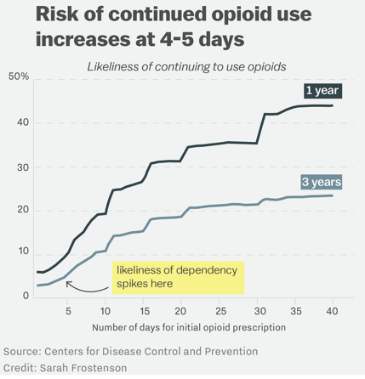
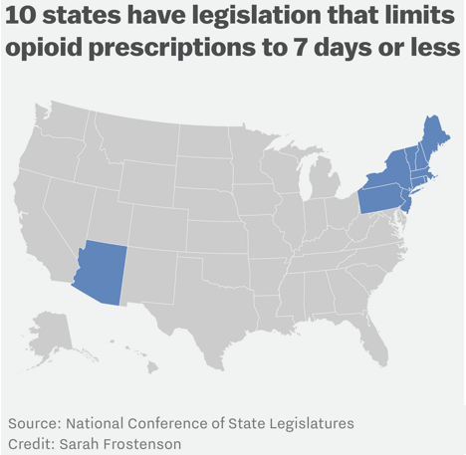
The Risk of a Single 5-day Opioid Prescription
States are now cracking down on opioid prescriptions.
http://www.newsweek.com/cdc-opiate-addiction-572498
http://www.vox.com/2017/3/18/14954626/one-simple-way-to-curb-opioid-overuse-prescribe-them-for-3-days-or-less

Slide 25
Examples of current formulations designed to deter tampering
Technologies | Opioids (Company)
Physical barriers
ADPREM technology (Egalet): Erosion matrix | Morphine ER, Oxycodone ER(Egalet)
DETERx technology (COL-003): Multi-particulate waxy matrix | Oxycodone(Collegium Pharm)
EDACS matrix (EDACS): Extruded formulation | Tramadol(Akela Pharmaceuticals)
INTAC /TIMERx technology (Opana): Push-pull osmotic pump | Oxymorphone(Endo/Grünenthal)
ORADUR technology (Remoxy): Viscous gel formulation | Oxycodone (Pain Ther./King/Pfizer)
OROS technology (Exalgo): Crush-resistant property | Hydromorphone (CombinatoRx)
OTR (Other Time Release) technology: Gel-forming property | Oxycodone OTR(Purdue Pharma)
ReXista technology (ReXista): Alcohol resistant property | Oxycodone ER(IntelliPharmaCeutics)
SABER technology (Remoxy): Viscous gel | Oxycodone ER(King Pharm)
SECUREL technology (TQ-1015): Sustained release | Tramadol(TheraQuest)
Aversion (Chemical deterrent barrier)
Capsaicin causing intense burning discomfort
Niacin (AcuroxOxyADF): Unpleasant effects of niacin | Oxycodone IR+niacin (King/Acura)
Sodium lauryl sulfate (Oxecta) | Oxycodone IR+SLS (King)
Antagonist Combinations
Abuse-resistant technology (OxyNal): Antagonist | Oxycodone ER+naltrexone(Elite Pharm)
Sequestered antagonist technology (EMBEDA): Antagonist | Morphine ER+naltrexone(Alpha/King)
Non-sequestered antagonist technology (TALWIN NX) | Pentazocine+Naloxone(Sanofi-Aventis)

Slide 26
Urgent Needs for Effective Abuse-Deterrent Formulations & Devices
Electro-ceutical
Extraction Prevention
Implantable triggered-
release
Snorting Prevention
Abuse-Deterrent Formulations & Devices
Smart Devices
Smart Pills
Intervention
Treatment
Wearable
Device
Smoking Prevention
Long acting MP system
Quorum Activation

Slide 27
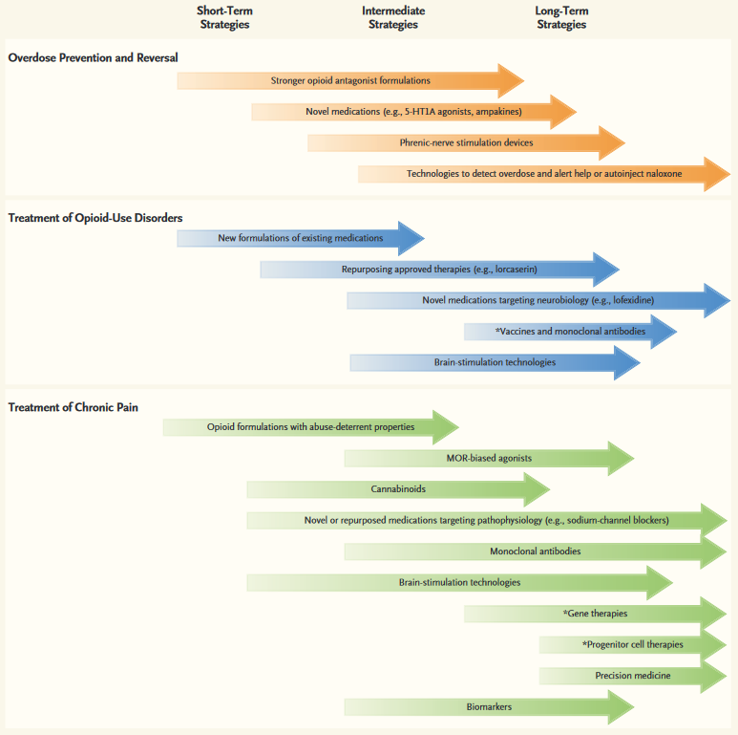
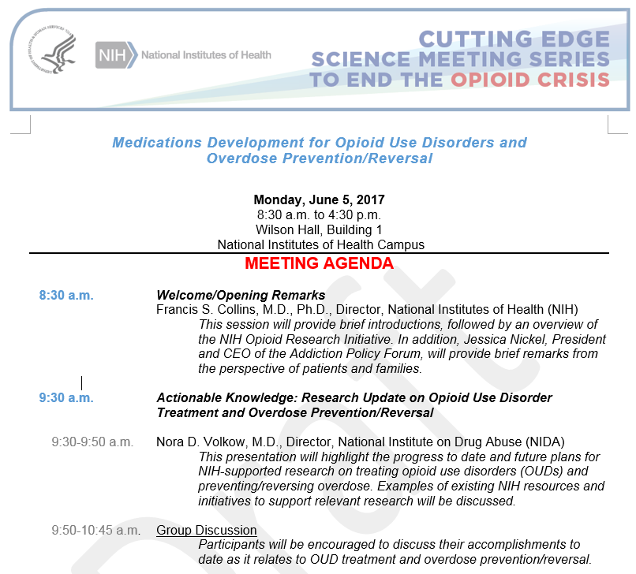
Cutting Edge Science Meeting Series to End the Opioid Crisis
Medications Development for Opioid Use Disorders and Overdose Prevention/Reversal
Overdose-Reversal Interventions
Treatments for Opioid Addiction
Nonaddictive Treatments for Chronic Pain
The Role of Science in Addressing the Opioid Crisis
Nora D. Volkow, M.D., and Francis S. Collins, M.D., Ph.D.
NEJM 2017

Slide 28
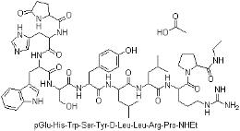
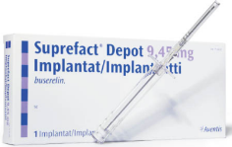
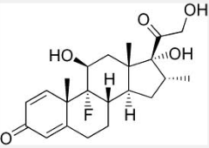
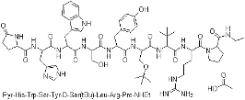
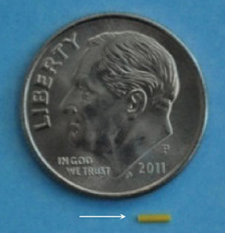
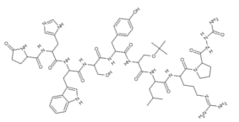
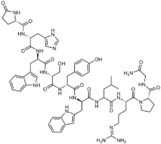
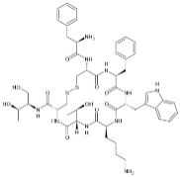
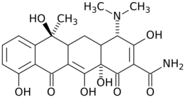
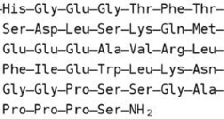
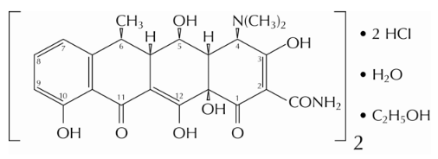
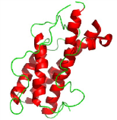
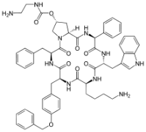
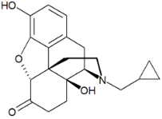
Injectable Long-Acting Formulations Approved by the FDA
MP: Microparticle.
SI: Solid implant.
IS: In Situ forming implant
1-4 months MP 1989
7.5 mg/month
Buserelin acetate
(Jan 26)
2, 3 months SI 2000
6.3 mg/2 months
3 months SI 2009
0.7 mg/3 months
1, 3 months SI 1989
3.6 mg/month (Dec 29)
1 month MP 2000
60 mg/month
6 months MP 2010
3.75 mg/month
1 month MP 1998
20 mg/month
2 weeks MP 2001
1 mg/2 weeks
1 week MP 2012, 2 mg/week
1 week, IS 1998
50 mg/week
1,3,4,6 months IS 2002
7.5 mg/month
3 month, MP 2012
3.75 mg/month
1 month MP 1999
13.5 mg/month (Discontinued)
2 weeks MP 2003
25 mg/2 weeks
1 month, MP 2014
20, 40, or 60 mg/month
1 month MP 2006
380 mg/month
1 month MP 2000
3.75 mg/month
1 month, MP 2015

Slide 29
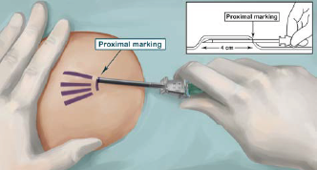
Overdose-Reversal Interventions
Probuphine 6-Mo Implant (ProNeura Technology):
80 mg buprenorphine HCl in EVA extruded matrix system. 26 mm long x 2.5 mm diameter (2016)
74.2 mg buprenorphine in each of 4 implants. Removal Required. US7736665
Dunbar, J.L. Alcohol Clin. Exp. Res. 30: 480-490, 2006.
NARCAN (naloxone)
The serum half-life in adults: 1 hour
0.4~2.0 mg IV, SubQ, IM
Naltrexone
The serum half-life in adults: 4 hours
50 mg oral daily
IM 380 mg every 4 weeks (14 mg/day)

Slide 30
Injectable Depot Systems for Opioid Drugs and Naltrexone
Long-Acting Depot Formulations
≈
Drug
Released
Opioid Drug
Naltrexone
≈
0 1 2 3 4 5 6 7 8 9 10 ≥ 30
Time (Day)

Slide 31
Injectable Depot Systems for Naltrexone
100%
Naltrexone
Released
0 1 2 3
Time (Week)

Slide 32
Randy Hountz
Director
Purdue Healthcare Advisors

Slide 33
PHA/RCHE Approach/Efforts
Systems Approach to Indiana’s Opioid Challenge
Fusion of systems thinking, strategic doing, and lean implementation
Briefly Review a Proposal Being Submitted 8/1

Slide 34
A Systems Approach
Phase I – Scope/Current State
Define success – targets, metrics
Select regions
Data – needs/analysis
Funding team
Phase II – Regional Prototyping
Strategic Doing
ID/alignment of resources
Regional action plans
Implementation – lean and other
Phase III – Deployment/Scale
Statewide rollout
Deployment support
Statewide demand/capacity management

Slide 35
Phase I – Scope/Current State
Statewide agreement on outcome metrics and improvement targets
Data availability/needs
Analysis of gaps (medical providers, behavioral health providers, substance abuse assistance, etc.)
Determine pilot regions
Obtain funding
5 workstreams
Project Management, Strategic Doing, Implementation, Funding Solicitation, Training/Scalability

Slide 36
Phase II - Regional Prototyping
Strategic Doing (Purdue Agile Strategy Lab)
Systematic community collaboration and experimentation
Shared objectives/commitment to action
Wide array of community successes
Flint lead water crisis
Health communities – Australia
Rural economic development
Funding – SBIR 3-tier funding approach
Increased capacity via process improvement

Slide 37
Phase III - Deployment/Scale/Research
Scale to other regions
Statewide demand/capacity management
Funding model – co-funding via SBIR approach
Potential research examples
Predictive model for INSPECT in various settings
Estimating comparative effectiveness of various opioid interventions (drug courts, MAT, etc.)
Risk stratification to identify high-risk patients

Slide 38
Capacity Example
Mental Health Provider
Project 1 – decreasing wait time for visit
Visit wait times from 18 days to under 3
Liberated capacity with standard work and multi-practice collaboration and change management
Project 2 – fatherhood initiative
Average time referral to consent from 24 to 8 days
New billable services to be sustainable
Refined processes with standard work, better resource utilization, and change management

Slide 39
Opioids Proposal Example
DHHS – Office of Minority Health
Four Pronged Approach in Fayette County
Strategic Doing
Provider prescribing training – CME/MOC program
Includes QI, patient education, INSPECT usage, risk assessing for misuse
Process improvement – increase capacity
Motivational interviewing – increase skills via microlearning approach

